Slide 1
COMPUTER GRAPHICS AND MULTIMEDIA
CS3CO24

Slide 2
Unit 3
3-D Transformations: Translation, Rotation and Scaling. Parallel & Perspective Projection: Types of Parallel & Perspective Projection, Hidden Surface Elimination: Depth Comparison, Back Face Detection Algorithm, Painter’s Algorithm, and Z-Buffer Algorithm.

Slide 3
3 D transformation
3-D Transformation is the process of manipulating the view of a three-D object with respect to its original position by modifying its physical attributes through various methods of transformation.
3D Transformations in Computer Graphics can be generated by extending 2D Transformation. We can include z coordinate along with x and y coordinate. Also, We can use 3D Transformation to change the size, shape, position, or orientation of an object

Slide 4
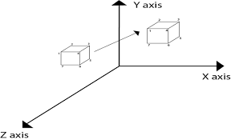
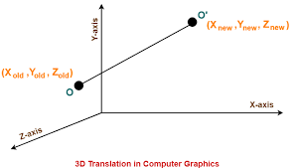
3 d transformation

Slide 5
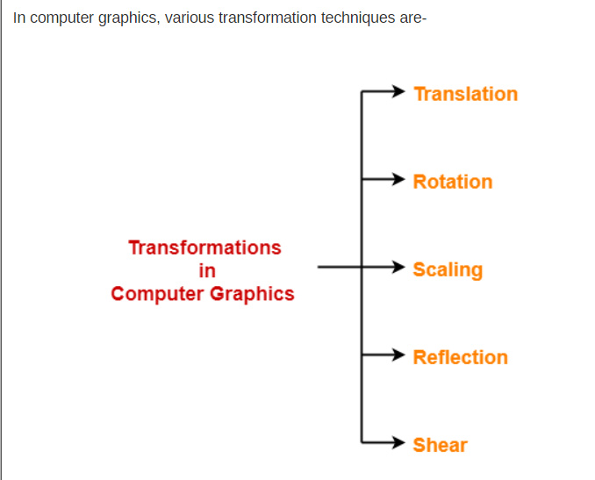
3 d transformation

Slide 6
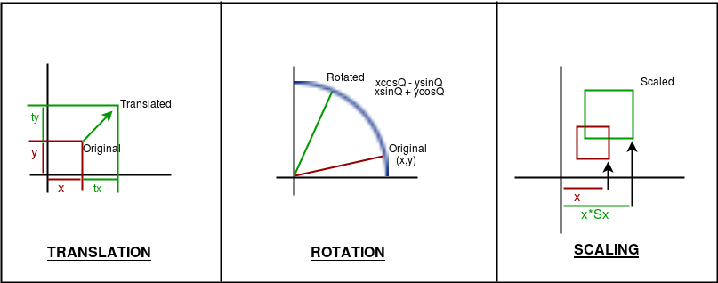
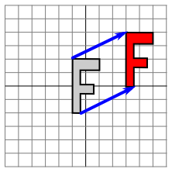
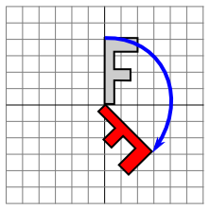
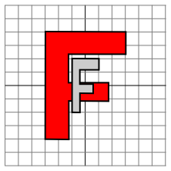

Slide 7
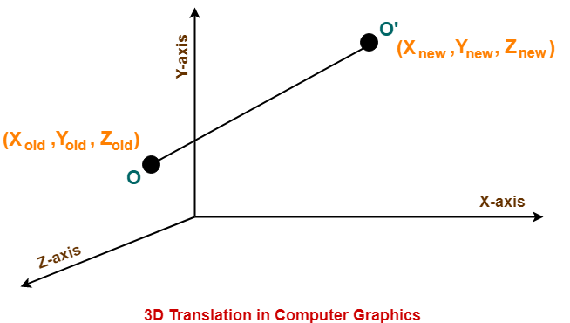
3 D TRANSLATION
3D Translation is a process of moving an object from one position to another in a three dimensional plane.
Consider a point object O has to be moved from one position to another in a 3D plane.
(tx, ty,tz)

Slide 8
3 D TRANSLATION
Let-
Initial coordinates of the object O = (X_{old}, Y_{old}, Z_{old})
New coordinates of the object O after translation = (X_{new}, Y_{new}, Z_{new})
Translation vector or Shift vector = (T_{x}, T_{y}, T_{z})

Slide 9
3 D TRANSLATION
Given a Translation vector (T_{x}, T_{y}, T_{z})-
T_{x} defines the distance the X_{old} coordinate has to be moved.
T_{y} defines the distance the Y_{old} coordinate has to be moved.
T_{z} defines the distance the Z_{old} coordinate has to be moved.

Slide 10
3 D TRANSLATION
This translation is achieved by adding the translation coordinates to the old coordinates of the object as-
X_{new} = X_{old} + T_{x} (This denotes translation towards X axis)
Y_{new} = Y_{old} + T_{y} (This denotes translation towards Y axis)
Z_{new} = Z_{old} + T_{z} (This denotes translation towards Z axis)

Slide 11
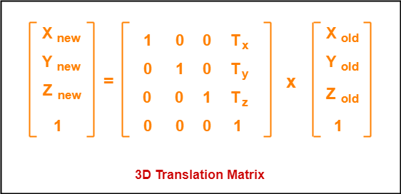
3 D TRANSLATION
In Matrix form, the above translation equations may be represented as-

Slide 12
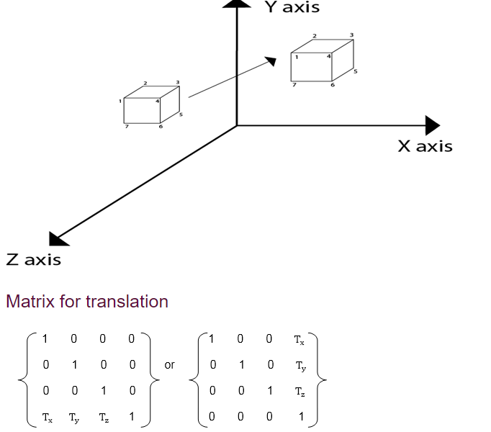

Slide 13
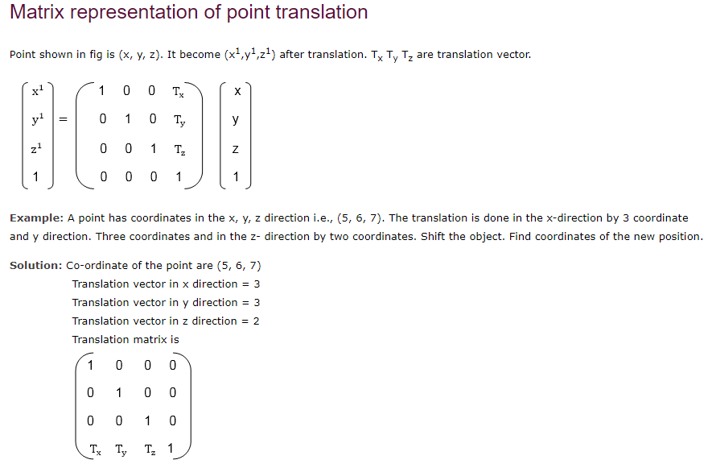

Slide 14
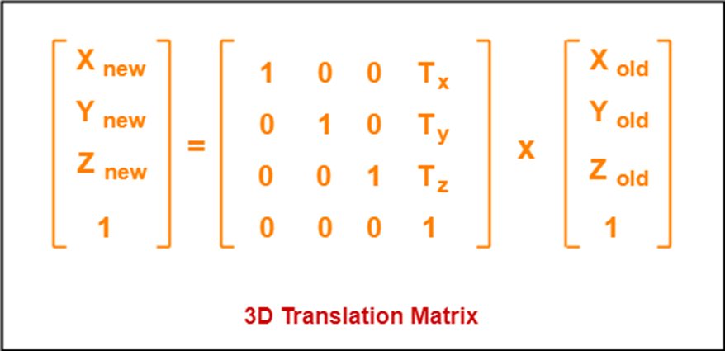
3 d translation
1 0 0 3 5
0 1 0 3 * 6
0 0 1 2 7
0 0 0 1 1
=(5+3), (6+3),(7+2),(1)
= (8,9,9,1)

Slide 15
3 d translation
X=5,Y=6, Z=7
Tx=3, ty=3, tz=2
Xnew = Xold+tx = 5+3= 8
Ynew = Yold+ty= 6+3= 9
Znew = Zold+tz = 7+2= 9

Slide 16
EXAMPLE
Given a 3D object with coordinate points A(0, 3, 1), B(3, 3, 2), C(3, 0, 0), D(0, 0, 0). Apply the translation with the distance 1 towards X axis, 1 towards Y axis and 2 towards Z axis and obtain the new coordinates of the object.
Solution:
Given-
Old coordinates of the object = A (0, 3, 1), B(3, 3, 2), C(3, 0, 0), D(0, 0, 0)
Translation vector = (T_{x}, T_{y}, T_{z}) = (1, 1, 2)

Slide 17
3 d translation
For Coordinates A(0, 3, 1)
old coordinates values are (X_{old}, Y_{old}, Z_{old}) = (0,3,1)
Let the new coordinates of A = (X_{new}, Y_{new}, Z_{new}).
Applying the translation equations, we have-
X_{new} = X_{old} + T_{x} = 0 + 1 = 1
Y_{new} = Y_{old} + T_{y} = 3 + 1 = 4
Z_{new} = Z_{old} + T_{z} = 1 + 2 = 3
Thus, New coordinates of A = (1, 4, 3).

Slide 18
3 d translation
For Coordinates B(3, 3, 2)
old coordinates values are (X_{old}, Y_{old}, Z_{old}) = (3,3,2)
Let the new coordinates of B = (X_{new}, Y_{new}, Z_{new}).
Applying the translation equations, we have-
X_{new} = X_{old} + T_{x} = 3 + 1 = 4
Y_{new} = Y_{old} + T_{y} = 3 + 1 = 4
Z_{new} = Z_{old} + T_{z} = 2 + 2 = 4
Thus, New coordinates of B = (4, 4, 4).

Slide 19
3 d translation
For Coordinates C(3, 0, 0)
old coordinates values are (X_{old}, Y_{old}, Z_{old}) = (3,0,0)
Let the new coordinates of C = (X_{new}, Y_{new}, Z_{new}).
Applying the translation equations, we have-
X_{new} = X_{old} + T_{x} = 3 + 1 = 4
Y_{new} = Y_{old} + T_{y} = 0 + 1 = 1
Z_{new} = Z_{old} + T_{z} = 0 + 2 = 2
Thus, New coordinates of C = (4, 1, 2).

Slide 20
3 d translation
For Coordinates D(0, 0, 0)
old coordinates values are (X_{old}, Y_{old}, Z_{old}) = (0,0,0)
Let the new coordinates of D = (X_{new}, Y_{new}, Z_{new}).
Applying the translation equations, we have-
X_{new} = X_{old} + T_{x} = 0 + 1 = 1
Y_{new} = Y_{old} + T_{y} = 0 + 1 = 1
Z_{new} = Z_{old} + T_{z} = 0 + 2 = 2
Thus, New coordinates of D = (1, 1, 2).

Slide 21
3 d translation
Thus, New coordinates of the object
A (1, 4, 3), B(4, 4, 4), C(4, 1, 2), D(1, 1, 2).

Slide 22
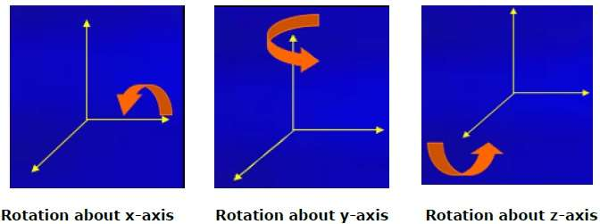
3 D ROTATION
3D Rotation is a process of rotating an object with respect to an angle in a three dimensional plane.
Positive rotation direction about the coordinate axes are counter clock wise

Slide 23
3 D ROTATION
Consider a point object O has to be rotated from one angle to another in a 3D plane.
Let-
Initial coordinates of the object O = (X_{old}, Y_{old}, Z_{old})
Initial angle of the object O with respect to origin = Φ
Rotation angle = θ
New coordinates of the object O after rotation = (X_{new}, Y_{new}, Z_{new})

Slide 24
3 D ROTATION
In 3 dimensions, there are 3 possible types of rotation-
X-axis Rotation
Y-axis Rotation
Z-axis Rotation

Slide 25
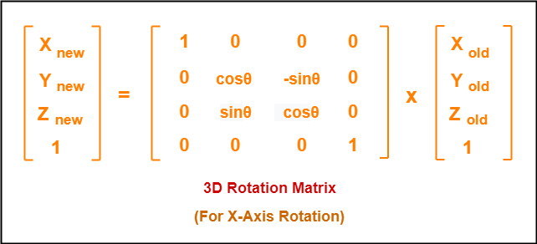
3 D ROTATION
For X-Axis Rotation-
X_{new} = X_{old}
Y_{new} = Y_{old} x cosθ – Z_{old} x sinθ
Z_{new} = Y_{old} x sinθ + Z_{old} x cosθ

Slide 26
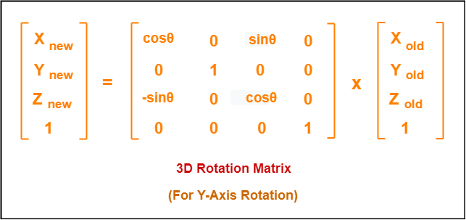
3 D ROTATION
For Y-Axis Rotation-
X_{new} = Z_{old} x sinθ + X_{old} x cosθ
Y_{new} = Y_{old}
Z_{new} = Z_{old} x cosθ – X_{old} x sinθ

Slide 27
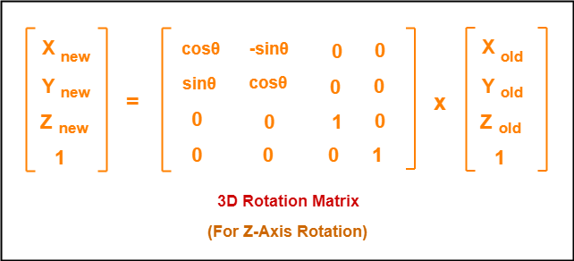
3 D ROTATION
For Z-Axis Rotation-
X_{new} = X_{old} x cosθ – Y_{old} x sinθ
Y_{new} = X_{old} x sinθ + Y_{old} x cosθ
Z_{new} = Z_{old}

Slide 28
3 D ROTATION
Given a homogeneous point (1, 2, 3). Apply rotation 90 degree towards X, Y and Z axis and find out the new coordinate points.
Solution
Given-
Old coordinates = (X_{old}, Y_{old}, Z_{old}) = (1, 2, 3)
Rotation angle = θ = 90º

Slide 29
for x axis rotation
Let the new coordinates after rotation = (X_{new}, Y_{new}, Z_{new}).
Applying the rotation equations, we have-
X_{new} = X_{old} = 1
Y_{new} = Y_{old} x cosθ – Z_{old} x sinθ = 2 x cos90° – 3 x sin90° = 2 x 0 – 3 x 1 = -3
Z_{new} = Y_{old} x sinθ + Z_{old} x cosθ = 2 x sin90° + 3 x cos90° = 2 x 1 + 3 x 0 = 2
Thus, New coordinates after rotation = (1, -3, 2).

Slide 30
For y axis rotation
Let the new coordinates after rotation = (X_{new}, Y_{new}, Z_{new}).
Applying the rotation equations, we have-
X_{new} = Z_{old} x sinθ + X_{old} x cosθ = 3 x sin90° + 1 x cos90° = 3 x 1 + 1 x 0 = 3
Y_{new} = Y_{old} = 2
Z_{new} = Z_{old} x cosθ – X_{old} x sinθ = 2 x cos90° – 1 x sin90° = 2 x 0 – 1 x 1 = -1
Thus, New coordinates after rotation = (3, 2, -1).

Slide 31
For z axis rotation
Let the new coordinates after rotation = (X_{new}, Y_{new}, Z_{new}).
Applying the rotation equations, we have-
X_{new} = X_{old} x cosθ – Y_{old} x sinθ = 1 x cos90° – 2 x sin90° = 1 x 0 – 2 x 1 = -2
Y_{new} = X_{old} x sinθ + Y_{old} x cosθ = 1 x sin90° + 2 x cos90° = 1 x 1 + 2 x 0 = 1
Z_{new} = Z_{old} = 3
Thus, New coordinates after rotation = (-2, 1, 3).

Slide 32
3 d scaling
In computer graphics, scaling is a process of modifying or altering the size of objects.
Scaling may be used to increase or reduce the size of object.
Scaling subjects the coordinate points of the original object to change.
Scaling factor determines whether the object size is to be increased or reduced.
If scaling factor > 1, then the object size is increased.
If scaling factor < 1, then the object size is reduced.

Slide 33
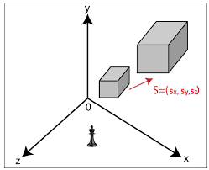
3 d scaling

Slide 34
3 d scaling
Consider a point object O has to be scaled in a 3D plane.
Let-
Initial coordinates of the object O = (X_{old}, Y_{old},Z_{old})
Scaling factor for X-axis = S_{x}
Scaling factor for Y-axis = S_{y}
Scaling factor for Z-axis = S_{z}
New coordinates of the object O after scaling = (X_{new}, Y_{new}, Z_{new})

Slide 35
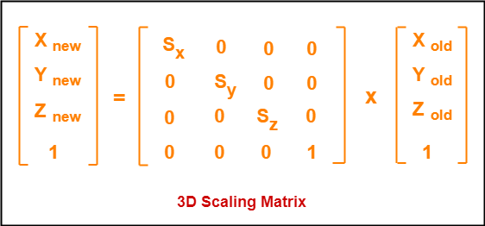
3 d scaling

Slide 36
3 d scaling
Given a 3D object with coordinate points A(0, 3, 3), B(3, 3, 6), C(3, 0, 1), D(0, 0, 0). Apply the scaling parameter 2 towards X axis, 3 towards Y axis and 3 towards Z axis and obtain the new coordinates of the object.
Old coordinates of the object = A (0, 3, 3), B(3, 3, 6), C(3, 0, 1), D(0, 0, 0)
Scaling factor along X axis = 2
Scaling factor along Y axis = 3
Scaling factor along Z axis = 3

Slide 37
For Coordinates A(0, 3, 3)
Let the new coordinates of A after scaling = (X_{new}, Y_{new}, Z_{new}).
Applying the scaling equations, we have-
X_{new} = X_{old} x S_{x} = 0 x 2 = 0
Y_{new} = Y_{old} x S_{y} = 3 x 3 = 9
Z_{new} = Z_{old} x S_{z} = 3 x 3 = 9
Thus, New coordinates of corner A after scaling = (0, 9, 9).

Slide 38
For Coordinates B(3, 3, 6)
Let the new coordinates of B after scaling = (X_{new}, Y_{new}, Z_{new}).
Applying the scaling equations, we have-
X_{new} = X_{old} x S_{x} = 3 x 2 = 6
Y_{new} = Y_{old} x S_{y} = 3 x 3 = 9
Z_{new} = Z_{old} x S_{z} = 6 x 3 = 18
Thus, New coordinates of corner B after scaling = (6, 9, 18).

Slide 39
For Coordinates C(3, 0, 1)
Let the new coordinates of C after scaling = (X_{new}, Y_{new}, Z_{new}).
Applying the scaling equations, we have-
X_{new} = X_{old} x S_{x} = 3 x 2 = 6
Y_{new} = Y_{old} x S_{y} = 0 x 3 = 0
Z_{new} = Z_{old} x S_{z} = 1 x 3 = 3
Thus, New coordinates of corner C after scaling = (6, 0, 3).

Slide 40
For Coordinates D(0, 0, 0)
Let the new coordinates of D after scaling = (X_{new}, Y_{new}, Z_{new}).
Applying the scaling equations, we have-
X_{new} = X_{old} x S_{x} = 0 x 2 = 0
Y_{new} = Y_{old} x S_{y} = 0 x 3 = 0
Z_{new} = Z_{old} x S_{z} = 0 x 3 = 0
Thus, New coordinates of corner D after scaling = (0, 0, 0).

Slide 41
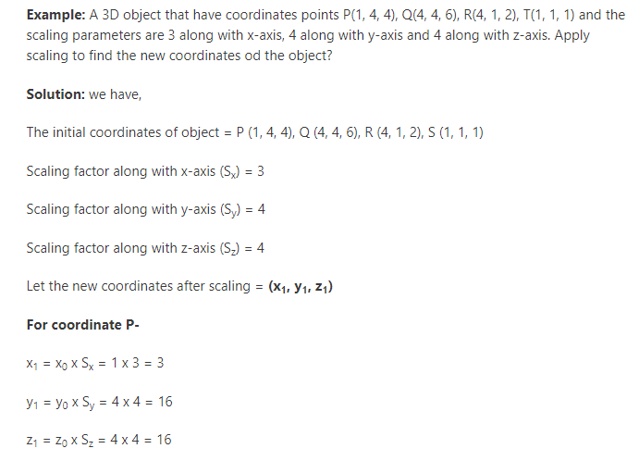

Slide 42
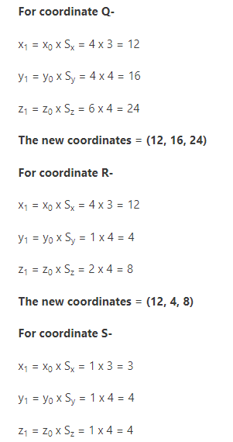
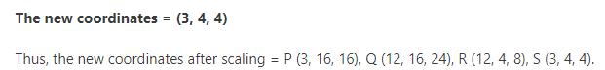

Slide 43
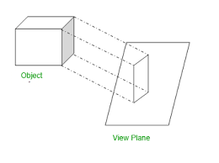
Projection:
Projection:- Projection is a technique which is used to transform a 3D object into a 2D plane. It is defined as the mapping or transformation of the object in a view plane. The view plane is displayed surface.

Slide 44
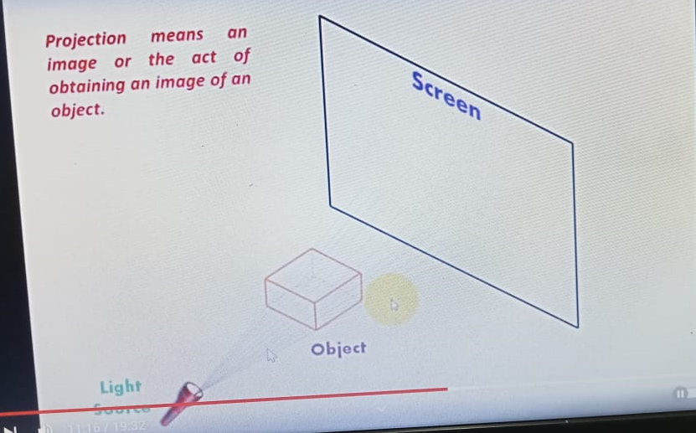
Projection:

Slide 45
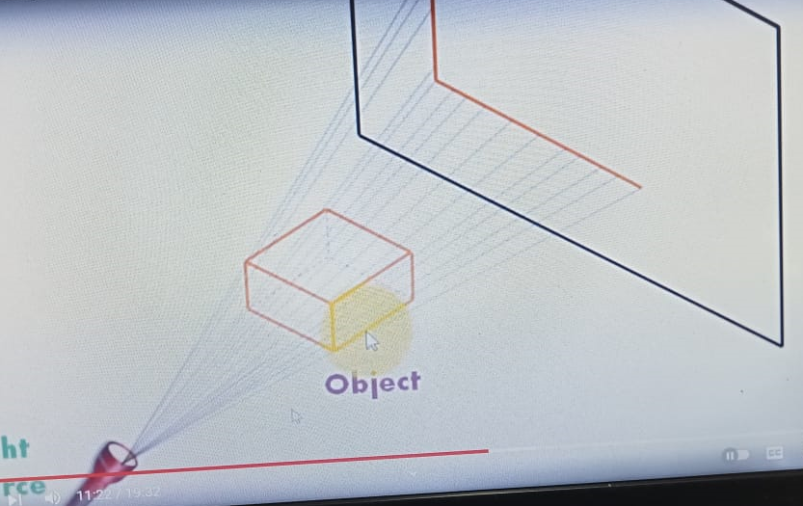
Projection:

Slide 46
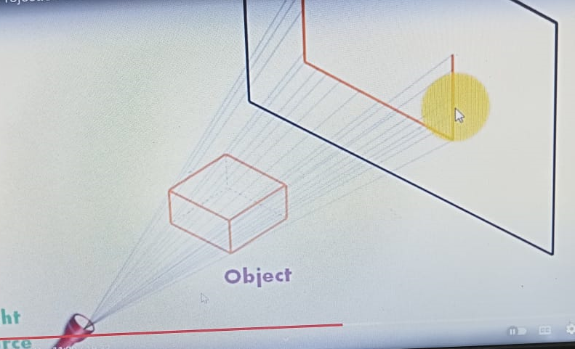
Projection:

Slide 47
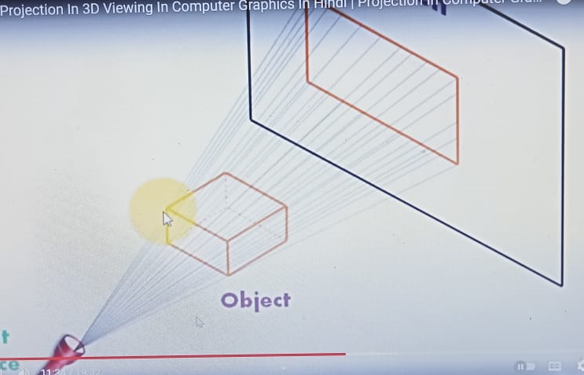
Projection:

Slide 48
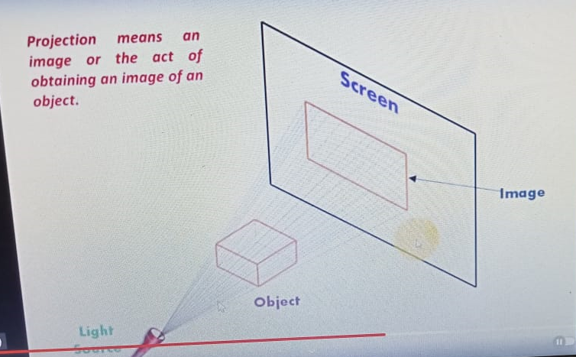
Projection:

Slide 49
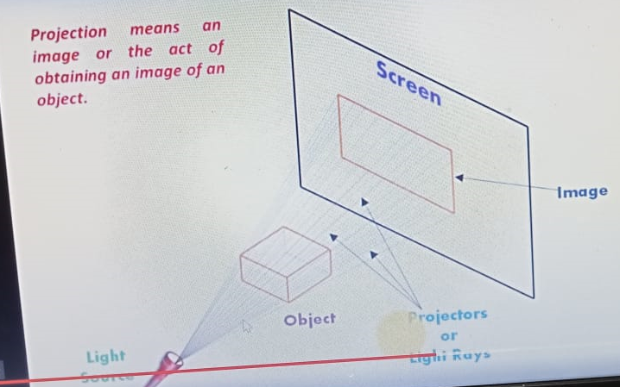
Projection:

Slide 50
Types of Projection:
In Computer Graphics, there are mainly two types of projection, these are:
1. Parallel Projection
2. Perspective Projection

Slide 51
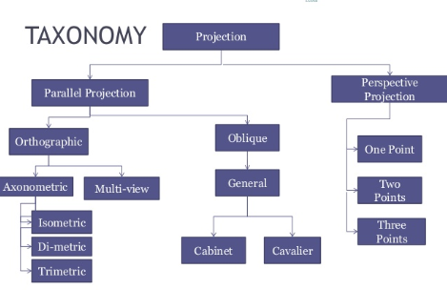

Slide 52
Types of Projection:
1. Parallel Projection:- coordinate positions are transformed to the view plane along parallel lines.

Slide 54
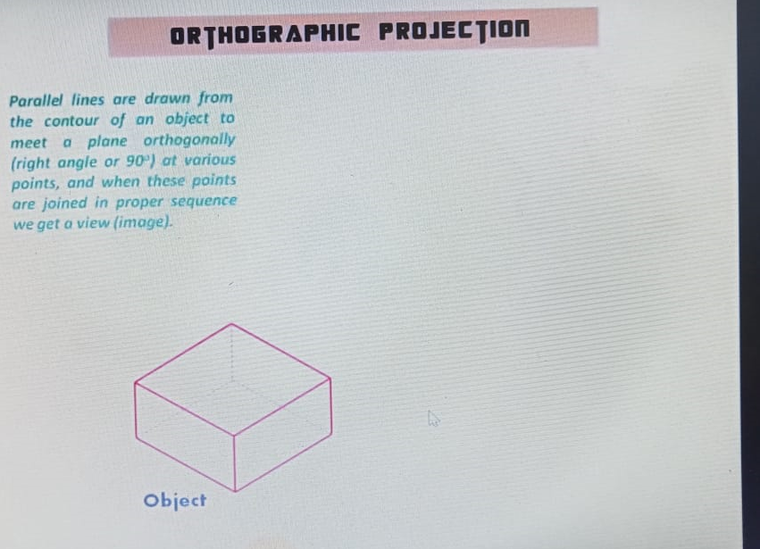

Slide 55
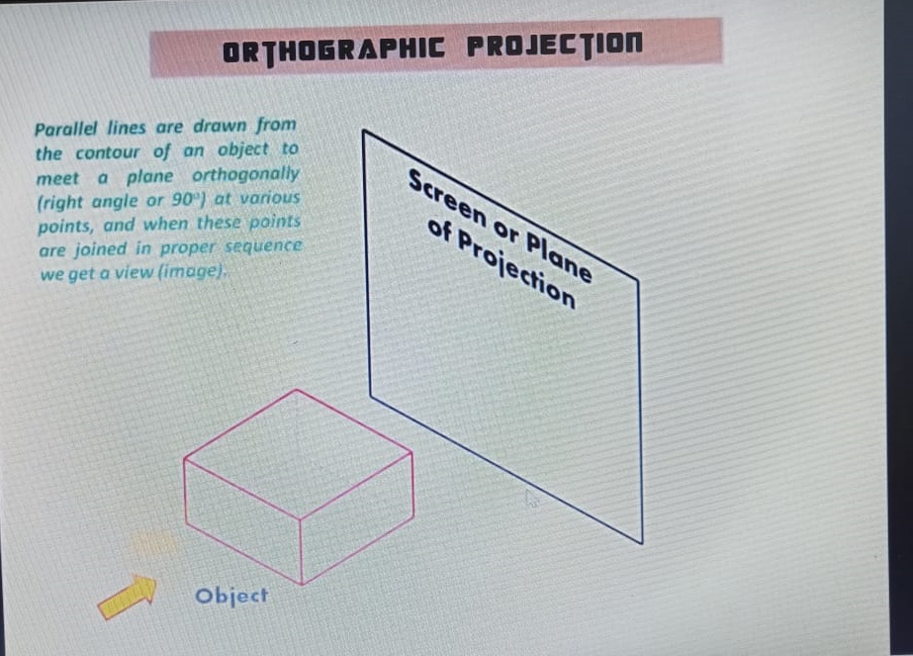

Slide 56
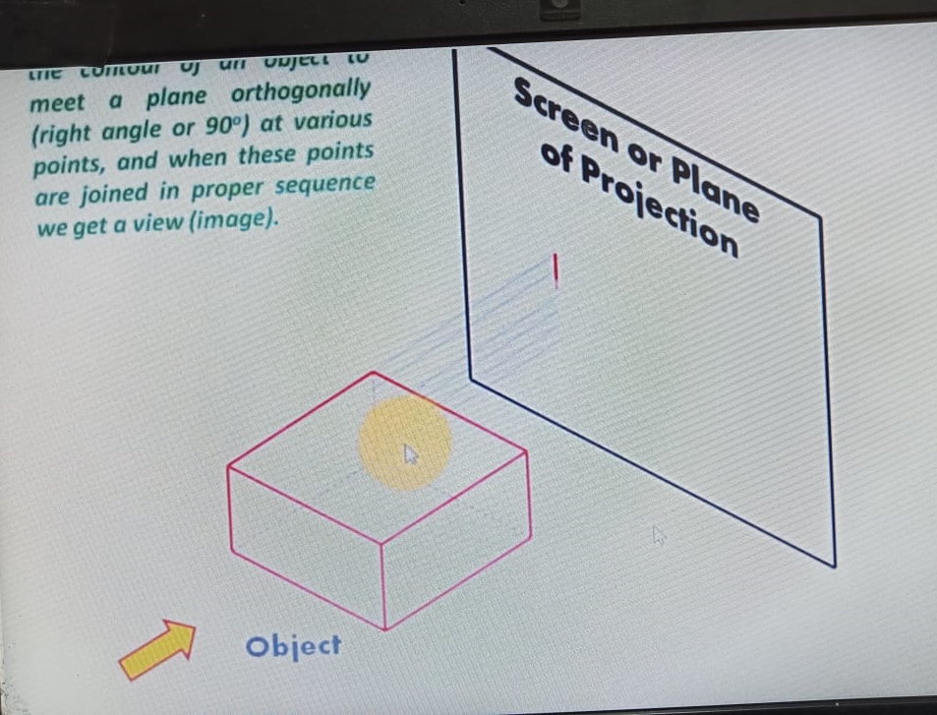

Slide 57
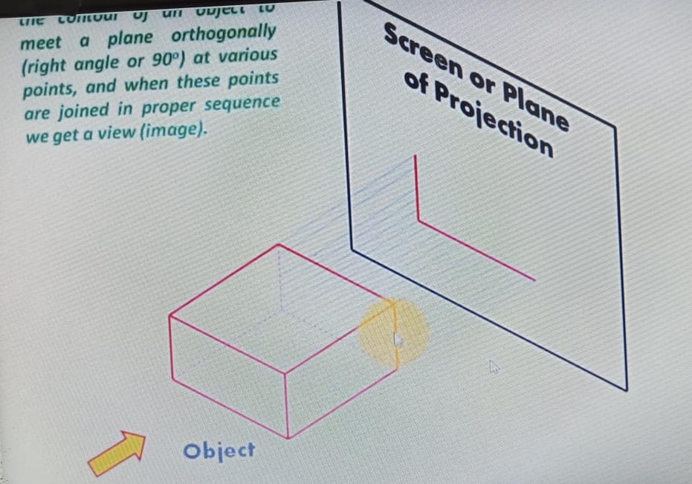

Slide 58
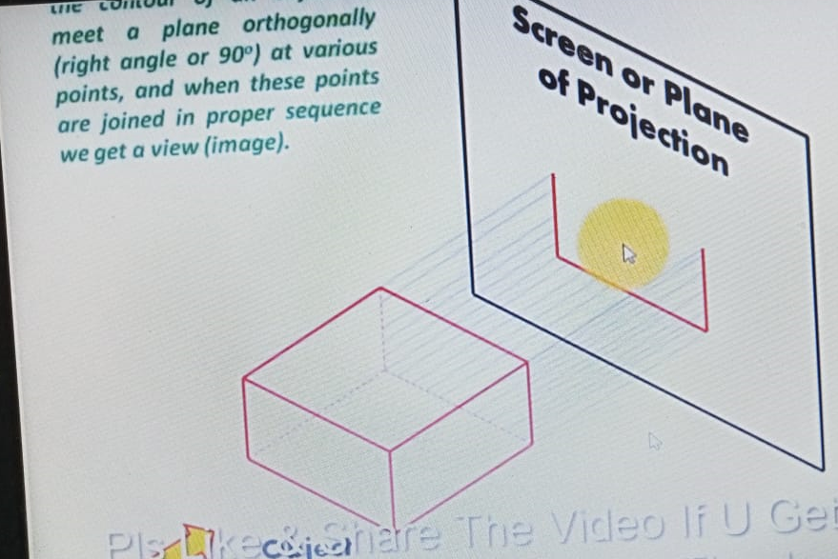

Slide 59
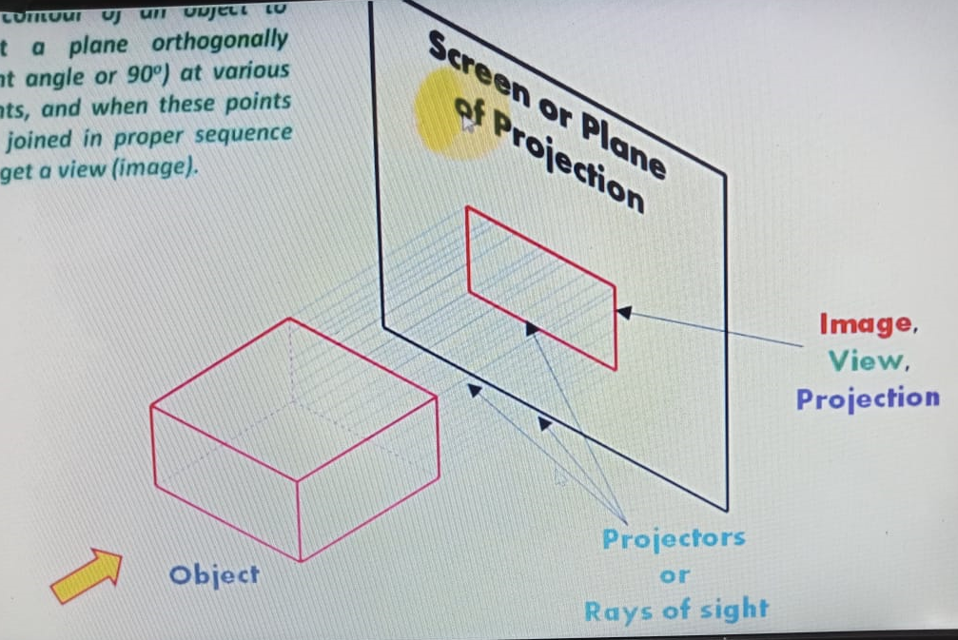

Slide 61
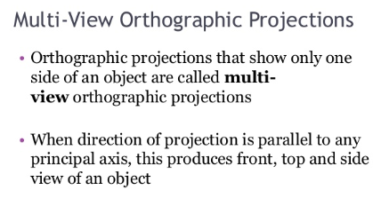

Slide 62
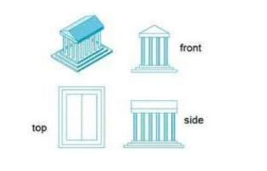
Multiview orthographic projection

Slide 63
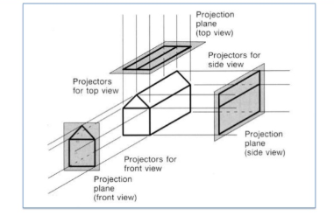
Multiview orthographic projection

Slide 64
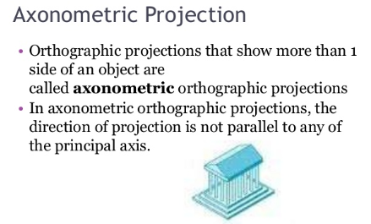
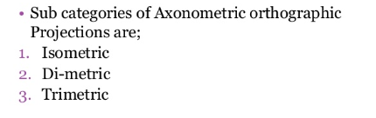

Slide 65
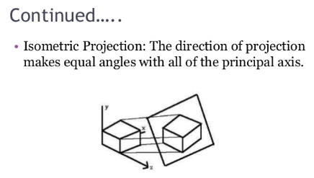
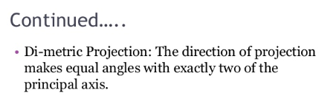
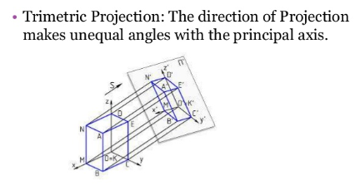

Slide 66
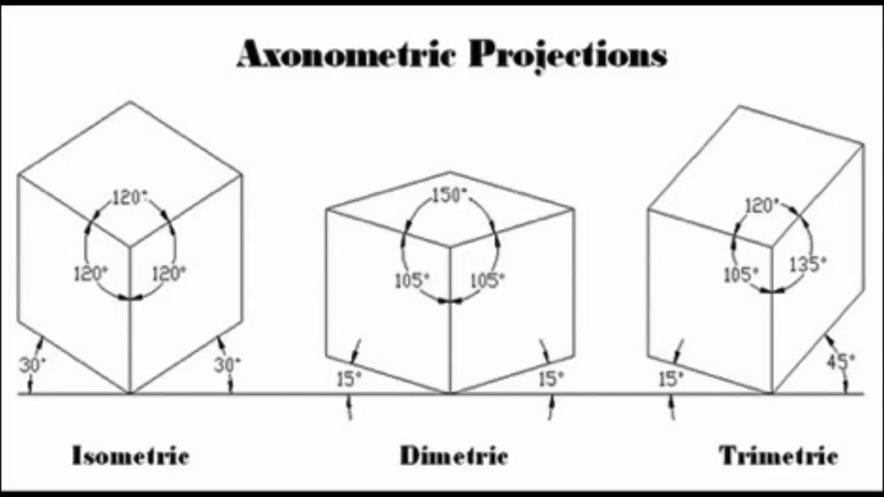

Slide 68
Types of Projection:
2. Oblique Projection : It is a kind of parallel projection where projecting rays emerges parallelly from the surface of the polygon and incident at an angle other than 90 degrees on the plane.

Slide 69
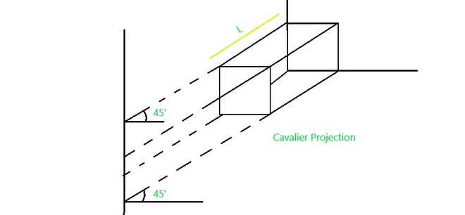
Types of Projection:
1. Cavalier Projection : It is a kind of oblique projection where the projecting lines emerge parallelly from the object surface and incident at 45‘ rather than 90′ at the projecting plane. In this projection, the length of the reading axis is larger than the cabinet projection.

Slide 70
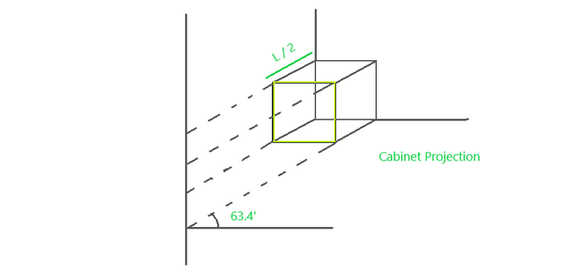
Types of Projection:
2. Cabinet Projection : It is similar to that cavalier projection but here the length of reading axes just half than the cavalier projection and the incident angle at the projecting plane is 63.4′ rather 45′.

Slide 71

Types of Projection:
2. Perspective Projection:- object position are transformed to the view plane along the lines that converge to a point called the projection reference point( center of projection).

Slide 72

Types of Projection:
2. Perspective Projection:- object position are transformed to the view plane along the lines that converge to a point called the projection reference point( center of projection).

Slide 73
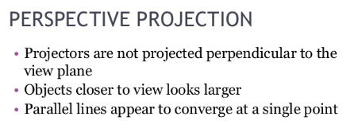
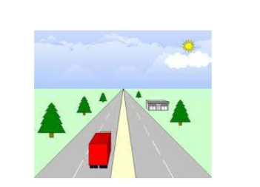

Slide 74
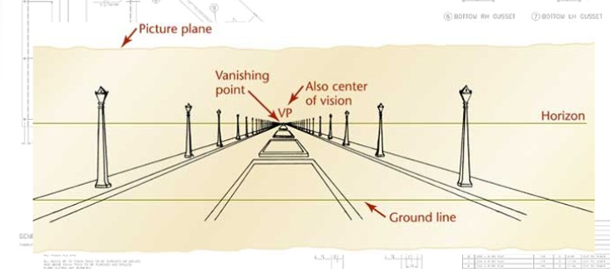

Slide 75
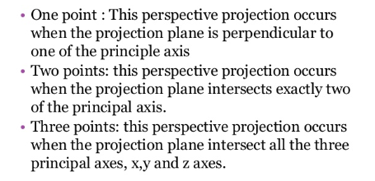


Slide 76



Slide 77


Slide 78


Slide 79
Types of hidden surface detection algorithms
Object space methods
Image space methods

Slide 80


Slide 81
Visible-Surface Detection
Problem:
Given a scene and a projection,
what can we see?

Slide 82
Visible-Surface Detection
Two main types of algorithms:
Object space: Determine which part of the object are visible
Image space: Determine per pixel which point of an object is visible
Object space Image space
H&B 16-1:504

Slide 83
Types of methods
Object space methods: In this method, various parts of objects are compared. After comparison visible, invisible or hardly visible surface is determined. These methods generally decide visible surface. In the wireframe model, these are used to determine a visible line. So these algorithms are line based instead of surface based. Method proceeds by determination of parts of an object whose view is obstructed by other object and draws these parts in the same color.

Slide 84
Types of methods
Image space methods: Positions of various pixels are determined. It is used to locate the visible surface instead of a visible line. Each point is detected for its visibility. If a point is visible, then the pixel is on, otherwise off. So the object close to the viewer that is pierced by a projector through a pixel is determined. That pixel is drawn is appropriate color.

Slide 85
Types of methods
Object space method
Back-face detection elimination
Robert’s algorithm
Image Space Method
Depth-buffer(depth comparison, Z- buffer)
Ray-casting (ray tracing)
Area subdivision method
Octree method
Scan line method
Painter’s algorithm(Depth-sorting, Z-Sorting) uses both the methods.

Slide 86

Back face detection

Slide 87


Slide 88


Slide 89


Slide 90


Slide 91


Slide 92

Depth-buffer(depth comparison, Z- buffer)

Slide 93

Depth buffer( z-buffer) algorithm

Slide 94


Slide 95


Slide 96

Depth buffer( z-buffer) algorithm

Slide 97


Slide 98


Slide 99


Slide 100


Slide 101
THANK YOU

